Slide 1

NoSQL
By Perry Hoekstra
Technical Consultant
Perficient, Inc.
perry.hoekstra@perficient.com

Slide 2
Why this topic?
Client’s Application Roadmap
  “Reduction of cycle time for the document intake process. Currently, it can take anywhere from a few days to a few weeks from the time the documents are received to when they are available to the client.”
New York Times used Hadoop/MapReduce to convert pre-1980 articles that were TIFF images to PDF.
Notes:
-> Read an article how the NYT used Hadoop/MapReduce, Amazon S3, and Amazon EC2 to convert 4TB of TIFF images into PDFs (http://open.blogs.nytimes.com/tag/mapreduce)
-> Had just read a client’s Application Roadmap where one of the listed benefits was to reduce the document intake process.
-> These two processes may be completely different and not applicable but it would be nice to have enough knowledge to know that Hadoop/MapReduce would not work in this situation or know enough to say ‘Eureka!’

Slide 3
Agenda
Some history
What is NoSQL
CAP Theorem
What is lost
Types of NoSQL
Data Model
Frameworks
Demo
Wrapup

Slide 4
History of the World, Part 1
Relational Databases – mainstay of business
Web-based applications caused spikes
  Especially true for public-facing e-Commerce sites
Developers begin to front RDBMS with memcache or integrate other caching mechanisms within the application (ie. Ehcache)
Notes:
-> For the longest time (and still true today), the big relational database vendors such as Oracle, IBM, Sybase, and a lesser extent Microsoft were the mainstay of how data was stored.
-> During the Internet boom, startups looking for low-cost RDBMS alternatives turned to MySQL and PostgreSQL.
-> The ‘Slashdot Effect’ occurs when a popular website links to a smaller site, causing a massive increase in traffic.
-> Hooking your RDBMS to a web-based application was a recipe for headaches, they are OLTP in nature. Could have hundreds of thousands of visitors in a short-time span.
-> To mitigate, began to front the RDBMS with a read-only cache such as memcache to offload a considerable amount of the read traffic.
-> As datasets grew, the simple memcache/MySQL model (for lower-cost startups) started to become problematic.

Slide 5
Scaling Up
Issues with scaling up when the dataset is just too big
RDBMS were not designed to be distributed
Began to look at multi-node database solutions
Known as ‘scaling out’ or ‘horizontal scaling’
Different approaches include:
  Master-slave
  Sharding
Notes:
-> Best way to provide ACID and a rich query model is to have the dataset on a single machine.
-> However, there are limits to scaling up (Vertical Scaling).
-> Past a certain point, an organization will find it is cheaper and more feasible to scale out (horizontal scaling) by adding smaller, more inexpensive (relatively) servers rather than investing in a single larger server.
-> A number of different approaches to scaling out (Horizontal Scaling).
-> DBAs began to look at master-slave and sharding as a strategy to overcome some of these issues.

Slide 6
Scaling RDBMS – Master/Slave
Master-Slave
  All writes are written to the master. All reads performed against the replicated slave databases
  Critical reads may be incorrect as writes may not have been propagated down
  Large data sets can pose problems as master needs to duplicate data to slaves

Slide 7
Scaling RDBMS - Sharding
Partition or sharding
  Scales well for both reads and writes
  Not transparent, application needs to be partition-aware
  Can no longer have relationships/joins across partitions
  Loss of referential integrity across shards
Notes:
-> Different sharding approaches:
-> Vertical Partitioning: Have tables related to a specific feature sit on their own server. May have to rebalance or reshard if tables outgrow server.
-> Range-Based Partitioning: When single table cannot sit on a server, split table onto multiple servers. Split table based on some critical value range.
-> Key or Hash-Based partitioning: Use a key value in a hash and use the resulting value as entry into multiple servers.
-> Directory-Based Partitioning: Have a lookup service that has knowledge of the partitioning scheme . This allows for the adding of servers or
changing the partition scheme without changing the application.
-> http://adam.heroku.com/past/2009/7/6/sql_databases_dont_scale

Slide 8
Other ways to scale RDBMS
Multi-Master replication
INSERT only, not UPDATES/DELETES
No JOINs, thereby reducing query time
  This involves de-normalizing data
In-memory databases
Notes:
-> The multi-master replication system is responsible for propagating data modifications made by each member to the rest of the group, and resolving any conflicts that might arise between concurrent changes made by different members.
-> For INSERT-only, data is versioned upon update.
-> Data is never DELETED, only inactivated.
-> JOINs are expensive with large volumes and don’t work across partitions.
-> Denormalization leads to even larger databases, reduces query time.
-> Consistency is the responsibility of the application.
-> In-memory databases have not caught on mainstream and regular RDBMS are more disk-intensive that memory-intensive. Vendors looking to fix this.

Slide 9
What is NoSQL?
Stands for Not Only SQL
Class of non-relational data storage systems
Usually do not require a fixed table schema nor do they use the concept of joins
All NoSQL offerings relax one or more of the ACID properties (will talk about the CAP theorem)
Notes:
-> NoSQL was a term coined by Eric Evans. He states that ‘… but the whole point of seeking alternatives is that you need to solve a problem that relational databases are a bad fit for. …
-> This is why people are continually interpreting nosql to be anti-RDBMS, it's the only rational conclusion when the only thing some of these projects share in common is that they are not relational databases.’
-> Emil Elfrem stated it is not a ‘NO’ SQL but more of a ‘Not Only” SQL.

Slide 10
Why NoSQL?
For data storage, an RDBMS cannot be the be-all/end-all
Just as there are different programming languages, need to have other data storage tools in the toolbox
A NoSQL solution is more acceptable to a client now than even a year ago
  Think about proposing a Ruby/Rails or Groovy/Grails solution now versus a couple of years ago
Notes:
-> Too often as consultants, when we talk about data storage, we immediately reach for a relational database.
-> Relational databases offer a very good general purpose solution to many different data storage needs.
-> In other words, it is the safe choice and will work in many situations.
-> Need to have some knowledge of alternatives, if nothing else to know when a NoSQL solution needs further investigation.

Slide 11
How did we get here?
Explosion of social media sites (Facebook, Twitter) with large data needs
Rise of cloud-based solutions such as Amazon S3 (simple storage solution)
Just as moving to dynamically-typed languages (Ruby/Groovy), a shift to dynamically-typed data with frequent schema changes
Open-source community
Notes:
-> However, the people with the largest datasets (terrabyte/petabyte) began to realize that sharding was putting a bandage on their issues. The more aggressive thought leaders (Google, Facebook, Twitter) began to explore alternative ways to store data. This became especially true in 2008/2009.
-> These datasets have high read/write rates.
-> With the advent of Amazon S3, a large respected vendor made the statement that maybe is was okay to look at alternative storage solutions other that relational.
-> All of the NoSQL options with the exception of Amazon S3 (Amazon Dynamo) are open-source solutions. This provides a low-cost entry point to ‘kick the tires’.

Slide 12
Dynamo and BigTable
Three major papers were the seeds of the NoSQL movement
  BigTable (Google)
  Dynamo (Amazon)
    Gossip protocol (discovery and error detection)
    Distributed key-value data store
    Eventual consistency
  CAP Theorem (discuss in a sec ..)
Notes:
-> BigTable: http://labs.google.com/papers/bigtable.html
-> Dynamo: http://www.allthingsdistributed.com/2007/10/amazons_dynamo.html and http://www.allthingsdistributed.com/files/amazon-dynamo-sosp2007.pdf
-> Amazon and consistency
* http://www.allthingsdistributed.com/2010/02
* http://www.allthingsdistributed.com/2008/12

Slide 13
The Perfect Storm
Large datasets, acceptance of alternatives, and dynamically-typed data has come together in a perfect storm
Not a backlash/rebellion against RDBMS
SQL is a rich query language that cannot be rivaled by the current list of NoSQL offerings
Notes:
-> So you have reached a point where a read-only cache and write-based RDBMS isn’t delivering the throughput necessary to support a particular application.
-> You need to examine alternatives and what alternatives are out there.
-> The NoSQL databases are a pragmatic response to growing scale of databases and the falling prices of commodity hardware.
-> Most likely, 10 years from now, the majority of data is still stored in RDBMS.

Slide 14
CAP Theorem
Three properties of a system: consistency, availability and partitions
You can have at most two of these three properties for any shared-data system
To scale out, you have to partition. That leaves either consistency or availability to choose from
  In almost all cases, you would choose availability over consistency
Notes:
-> Proposed by Eric Brewer (talk on Principles of Distributed Computing July 2000).
-> Partitionability: divide nodes into small groups that can see other groups, but they can't see everyone.
-> Consistency: write a value and then you read the value you get the same value back. In a partitioned system there are windows where that's not true.
-> Availability: may not always be able to write or read. The system will say you can't write because it wants to keep the system consistent.
-> To scale you have to partition, so you are left with choosing either high consistency or high availability for a particular system. You must find the right
overlap of availability and consistency.
-> Choose a specific approach based on the needs of the service.
-> For the checkout process you always want to honor requests to add items to a shopping cart because it's revenue producing.
In this case you choose high availability. Errors are hidden from the customer and sorted out later.
-> When a customer submits an order you favor consistency because several services--credit card processing, shipping and handling, reporting—
are simultaneously accessing the data.

Slide 15
Availability
Traditionally, thought of as the server/process available five 9’s (99.999 %).
However, for large node system, at almost any point in time there’s a good chance that a node is either down or there is a network disruption among the nodes.
  Want a system that is resilient in the face of network disruption

Slide 16
Consistency Model
A consistency model determines rules for visibility and apparent order of updates.
For example:
  Row X is replicated on nodes M and N
  Client A writes row X to node N
  Some period of time t elapses.
  Client B reads row X from node M
  Does client B see the write from client A?
  Consistency is a continuum with tradeoffs
  For NoSQL, the answer would be: maybe
  CAP Theorem states: Strict Consistency can't be achieved at the same time as availability and partition-tolerance.
Notes:
-> http://cloudera-todd.s3.amazonaws.com/nosql.pdf

Slide 17
Eventual Consistency
When no updates occur for a long period of time, eventually all updates will propagate through the system and all the nodes will be consistent
For a given accepted update and a given node, eventually either the update reaches the node or the node is removed from service
Known as BASE (Basically Available, Soft state, Eventual consistency), as opposed to ACID
Notes:
-> http://en.wikipedia.org/wiki/Eventual_consistency
-> http://www.allthingsdistributed.com/2008/12/eventually_consistent.html
The types of large systems based on CAP aren't ACID they are BASE (http://queue.acm.org/detail.cfm?id=1394128):
* Basically Available - system seems to work all the time
* Soft State - it doesn't have to be consistent all the time
* Eventually Consistent - becomes consistent at some later time
Everyone who builds big applications builds them on CAP and BASE: Google, Yahoo, Facebook, Amazon, eBay, etc

Slide 18
What kinds of NoSQL
NoSQL solutions fall into two major areas:
  Key/Value or ‘the big hash table’.
    Amazon S3 (Dynamo)
    Voldemort
    Scalaris
  Schema-less which comes in multiple flavors, column-based, document-based or graph-based.
    Cassandra (column-based)
    CouchDB (document-based)
    Neo4J (graph-based)
    HBase (column-based)
Notes:
-> Not an exhaustive list, just some of the more well-known.
-> HBase is the data storage solution for Hadoop.
-> Graph: is a network database that uses edges and nodes to represent and store data.
-> Document: views are stored as rows which are kept sorted by key. Can adapt to variations in document structure.

Slide 19
Key/Value
Pros:
  very fast
  very scalable
  simple model
  able to distribute horizontally
Cons:
  - many data structures (objects) can't be easily modeled as key value pairs
Notes:
-> http://chariotsolutions.blogspot.com/2010/01/why-you-need-nosql-in-your-toolbox.html

Slide 20
Schema-Less
Pros:
  - Schema-less data model is richer than key/value pairs
  eventual consistency
  many are distributed
  still provide excellent performance and scalability
Cons:
  - typically no ACID transactions or joins

Slide 21
Common Advantages
Cheap, easy to implement (open source)
Data are replicated to multiple nodes (therefore identical and fault-tolerant) and can be partitioned
  Down nodes easily replaced
  No single point of failure
Easy to distribute
Don't require a schema
Can scale up and down
Relax the data consistency requirement (CAP)
Notes:
-> As the data is written, the latest version is on at least one node. The data is then versioned/replicated to other nodes within the system.
-> Eventually, the same version is on all nodes.

Slide 22
What am I giving up?
joins
group by
order by
ACID transactions
SQL as a sometimes frustrating but still powerful query language
easy integration with other applications that support SQL
Notes:
-> No JDBC
-> Data integrity at the application layer

Slide 23
Cassandra
Originally developed at Facebook
Follows the BigTable data model: column-oriented
Uses the Dynamo Eventual Consistency model
Written in Java
Open-sourced and exists within the Apache family
Uses Apache Thrift as it’s API

Slide 24
Thrift
Created at Facebook along with Cassandra
Is a cross-language, service-generation framework
Binary Protocol (like Google Protocol Buffers)
Compiles to: C++, Java, PHP, Ruby, Erlang, Perl, ...
Notes:
-> http://incubator.apache.org/thrift/static/thrift-20070401.pdf
-> http://incubator.apache.org/thrift/
-> Thrift also created by Facebook engineers and donated to Apache

Slide 25
Searching
Relational
  SELECT `column` FROM `database`,`table` WHERE `id` = key;
  SELECT product_name FROM rockets WHERE id = 123;
Cassandra (standard)
  keyspace.getSlice(key, “column_family”, "column")
  keyspace.getSlice(123, new ColumnParent(“rockets”), getSlicePredicate());

Slide 26
Typical NoSQL API
Basic API access:
  get(key) -- Extract the value given a key
  put(key, value) -- Create or update the value given its key
  delete(key) -- Remove the key and its associated value
  execute(key, operation, parameters) -- Invoke an operation to the value (given its key) which is a special data structure (e.g. List, Set, Map .... etc).
Notes:
-> http://horicky.blogspot.com/2009/11/nosql-patterns.html

Slide 27
Data Model
Within Cassandra, you will refer to data this way:
  Column: smallest data element, a tuple with a name and a value
    :Rockets, '1' might return:
    {'name' => ‘Rocket-Powered Roller Skates',
    ‘toon' => ‘Ready Set Zoom',
    ‘inventoryQty' => ‘5‘,
    ‘productUrl’ => ‘rockets\1.gif’}
Notes:
-> Have heard it referred to as a 4 or 5 dimensional hash table.

Slide 28
Data Model Continued
  ColumnFamily: There’s a single structure used to group both the Columns and SuperColumns. Called a ColumnFamily (think table), it has two types, Standard & Super.
    Column families must be defined at startup
  Key: the permanent name of the record
  Keyspace: the outer-most level of organization. This is usually the name of the application. For example, ‘Acme' (think database name).
Notes:
-> Keys have different numbers of columns, so the database can scale in an irregular way.
-> Simple and Super: super columns are columns within columns.
-> Refer to date by keyspace, a column family, a key, an optional super column, and a column.

Slide 29
Cassandra and Consistency
Talked previous about eventual consistency
Cassandra has programmable read/writable consistency
  One: Return from the first node that responds
  Quorom: Query from all nodes and respond with the one that has latest timestamp once a majority of nodes responded
  All: Query from all nodes and respond with the one that has latest timestamp once all nodes responded. An unresponsive node will fail the node
Notes:
-> http://www.slideshare.net/julesbravo/cassandra-3125809
-> Have a good simple benchmark to show to demonstrate difference between Cassandra and MySQL

Slide 30
Cassandra and Consistency
  Zero: Ensure nothing. Asynchronous write done in background
  Any: Ensure that the write is written to at least 1 node
  One: Ensure that the write is written to at least 1 node’s commit log and memory table before receipt to client
  Quorom: Ensure that the write goes to node/2 + 1
  All: Ensure that writes go to all nodes. An unresponsive node would fail the write

Slide 31
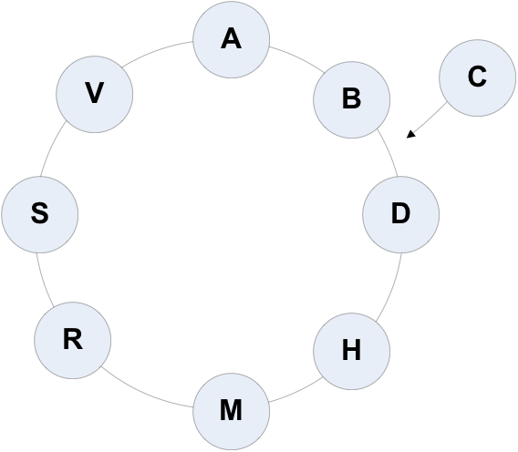
Consistent Hashing
Partition using consistent hashing
  Keys hash to a point on a fixed circular space
  Ring is partitioned into a set of ordered slots and servers and keys hashed over these slots
Nodes take positions on the circle.
A, B, and D exists.
  B responsible for AB range.
  D responsible for BD range.
  A responsible for DA range.
C joins.
  B, D split ranges.
  C gets BC from D.
Notes:
-> http://senguptas.org/Documents/cassandra_cs349c_presentation.pdf

Slide 32
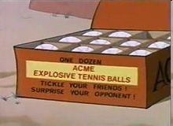


Domain Model
Design your domain model first
Create your Cassandra data store to fit your domain model
<Keyspace Name="Acme">
<ColumnFamily CompareWith="UTF8Type" Name="Rockets" />
<ColumnFamily CompareWith="UTF8Type" Name="OtherProducts" />
<ColumnFamily CompareWith="UTF8Type" Name="Explosives" />
…
</Keyspace>
Notes:
-> http://home.roadrunner.com/~tuco/looney/acme.html

Slide 33
Data Model
ColumnFamily: Rockets
Key
Value
1
Name
Value
name
Rocket-Powered Roller Skates
toon
Ready, Set, Zoom
inventoryQty
5
brakes
false
2
Name
Value
name
Little Giant Do-It-Yourself Rocket-Sled Kit
toon
Beep Prepared
inventoryQty
4
brakes
false
3
Name
Value
name
Acme Jet Propelled Unicycle
toon
Hot Rod and Reel
inventoryQty
1
wheels
1

Slide 34
Data Model Continued
  Optional super column: a named list. A super column contains standard columns, stored in recent order
    Say the OtherProducts has inventory in categories. Querying (:OtherProducts, '174927') might return:
    {‘OtherProducts' => {'name' => ‘Acme Instant Girl', ..}, ‘foods': {...}, ‘martian': {...}, ‘animals': {...}}
    In the example, foods, martian, and animals are all super column names. They are defined on the fly, and there can be any number of them per row. :OtherProducts would be the name of the super column family.
  Columns and SuperColumns are both tuples with a name & value. The key difference is that a standard Column’s value is a “string” and in a SuperColumn the value is a Map of Columns.

Slide 35
Data Model Continued
Columns are always sorted by their name. Sorting supports:
  BytesType
  UTF8Type
  LexicalUUIDType
  TimeUUIDType
  AsciiType
  LongType
Each of these options treats the Columns' name as a different data type

Slide 36
Hector
Leading Java API for Cassandra
Sits on top of Thrift
Adds following capabilities
  Load balancing
  JMX monitoring
  Connection-pooling
  Failover
  JNDI integration with application servers
  Additional methods on top of the standard get, update, delete methods.
Under discussion
  hooks into Spring declarative transactions
Notes:
-> Open-source at GitHub
-> Lead developer is Ran Tavoy

Slide 37
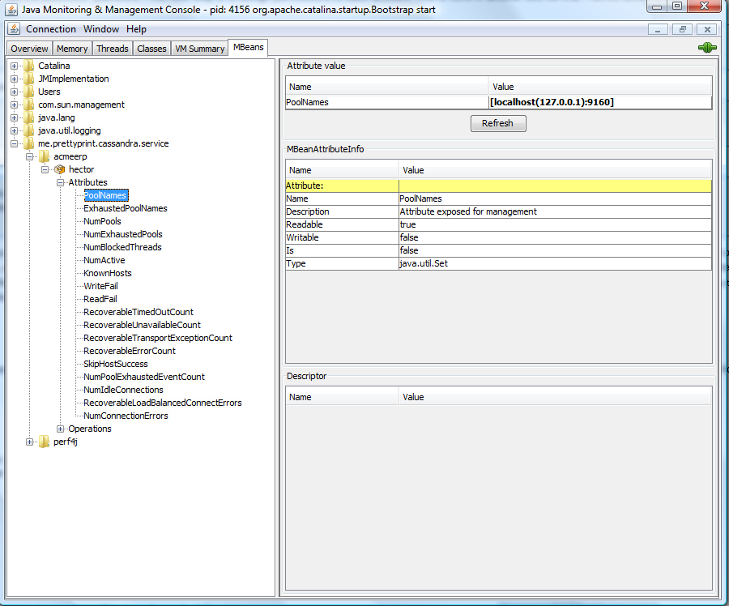
Hector and JMX
Notes:
-> Using JConsole

Slide 38
Code Examples: Tomcat Configuration
Tomcat context.xml
<Resource name="cassandra/CassandraClientFactory"
auth="Container"
type="me.prettyprint.cassandra.service.CassandraHostConfigurator"
factory="org.apache.naming.factory.BeanFactory"
hosts="localhost:9160"
maxActive="150"
maxIdle="75" />
J2EE web.xml
<resource-env-ref>
<description>Object factory for Cassandra clients.</description>
<resource-env-ref-name>cassandra/CassandraClientFactory</resource-env-ref-name>
<resource-env-ref-type>org.apache.naming.factory.BeanFactory</resource-env-ref-type>
</resource-env-ref>

Slide 39
Code Examples: Spring Configuration
Spring applicationContext.xml
<bean id="cassandraHostConfigurator“
class="org.springframework.jndi.JndiObjectFactoryBean">
<property name="jndiName">
<value>cassandra/CassandraClientFactory</value></property>
<property name="resourceRef"><value>true</value></property>
</bean>
<bean id="inventoryDao“
class="com.acme.erp.inventory.dao.InventoryDaoImpl">
<property name="cassandraHostConfigurator“
ref="cassandraHostConfigurator" />
<property name="keyspace" value="Acme" />
</bean>

Slide 40
Code Examples: Cassandra Get Operation
try {
cassandraClient = cassandraClientPool.borrowClient();
// keyspace is Acme
Keyspace keyspace = cassandraClient.getKeyspace(getKeyspace());
// inventoryType is Rockets
List<Column> result = keyspace.getSlice(Long.toString(inventoryId), new ColumnParent(inventoryType), getSlicePredicate());
inventoryItem.setInventoryItemId(inventoryId);
inventoryItem.setInventoryType(inventoryType);
loadInventory(inventoryItem, result);
} catch (Exception exception) {
logger.error("An Exception occurred retrieving an inventory item", exception);
} finally {
try {
cassandraClientPool.releaseClient(cassandraClient);
} catch (Exception exception) {
logger.warn("An Exception occurred returning a Cassandra client to the pool", exception);
}
}
Notes:
-> The purpose of these two slides is not to teach how to do Cassandra/Hector programming but to show how much programming needs to be done versus Hibernate
-> Back in the good old days of JDBC programming

Slide 41
Code Examples: Cassandra Update Operation
try {
cassandraClient = cassandraClientPool.borrowClient();
Map<String, List<ColumnOrSuperColumn>> data = new HashMap<String, List<ColumnOrSuperColumn>>();
List<ColumnOrSuperColumn> columns = new ArrayList<ColumnOrSuperColumn>();
// Create the inventoryId column.
ColumnOrSuperColumn column = new ColumnOrSuperColumn();
columns.add(column.setColumn(new Column("inventoryItemId".getBytes("utf-8"), Long.toString(inventoryItem.getInventoryItemId()).getBytes("utf-8"), timestamp)));
column = new ColumnOrSuperColumn();
columns.add(column.setColumn(new Column("inventoryType".getBytes("utf-8"), inventoryItem.getInventoryType().getBytes("utf-8"), timestamp)));
….
data.put(inventoryItem.getInventoryType(), columns);
cassandraClient.getCassandra().batch_insert(getKeyspace(), Long.toString(inventoryItem.getInventoryItemId()), data, ConsistencyLevel.ANY);
} catch (Exception exception) {
…
}

Slide 42
Some Statistics
Facebook Search
MySQL > 50 GB Data
  Writes Average : ~300 ms
  Reads Average : ~350 ms
Rewritten with Cassandra > 50 GB Data
  Writes Average : 0.12 ms
  Reads Average : 15 ms
Notes:
-> http://static.last.fm/johan/nosql-20090611/cassandra_nosql.ppt

Slide 43
Some things to think about
Ruby on Rails and Grails have ORM baked in. Would have to build your own ORM framework to work with NoSQL.
  Some plugins exist.
Same would go for Java/C#, no Hibernate-like framework.
  A simple JDO framework does exist.
Support for basic languages like Ruby.
Notes:
-> http://github.com/PedroGomes/datanucleus-cassandra (JDO)
-> http://github.com/wolpert/grails-cassandra

Slide 44
Some more things to think about
Troubleshooting performance problems
Concurrency on non-key accesses
Are the replicas working?
No TOAD for Cassandra
  though some NoSQL offerings have GUI tools
  have SQLPlus-like capabilities using Ruby IRB interpreter.
Notes:
-> Taken from: http://www.claassen.net/geek/blog/2010/02/nosql-is-new-arcadia.html

Slide 45
Don’t forget about the DBA
It does not matter if the data is deployed on a NoSQL platform instead of an RDBMS.
Still need to address:
  Backups & recovery
  Capacity planning
  Performance monitoring
  Data integration
  Tuning & optimization
What happens when things don’t work as expected and nodes are out of sync or you have a data corruption occurring at 2am?
Who you gonna call?
  DBA and SysAdmin need to be on board
Notes:
-> Need to educate the DBA rather than going around them.

Slide 46
Where would I use it?
For most of us, we work in corporate IT and a LinkedIn or Twitter is not in our future
Where would I use a NoSQL database?
Do you have somewhere a large set of uncontrolled, unstructured, data that you are trying to fit into a RDBMS?
  Log Analysis
  Social Networking Feeds (many firms hooked in through Facebook or Twitter)
  External feeds from partners (EAI)
  Data that is not easily analyzed in a RDBMS such as time-based data
  Large data feeds that need to be massaged before entry into an RDBMS
Notes:
http://www.infoq.com/articles/nosql-in-the-enterprise

Slide 47
Summary
Leading users of NoSQL datastores are social networking sites such as Twitter, Facebook, LinkedIn, and Digg.
To implement a single feature in Cassandra, Digg has a dataset that is 3 terabytes and 76 billion columns.
Not every problem is a nail and not every solution is a hammer.
Notes:
NoSQL has taken a field that was "dead" (database development) and suddenly brought it back to life.

Slide 48

Questions

Slide 49
Resources
Cassandra
  http://cassandra.apache.org
Hector
  http://wiki.github.com/rantav/hector
  http://prettyprint.me
NoSQL News websites
  http://nosql.mypopescu.com
  http://www.nosqldatabases.com
High Scalability
  http://highscalability.com
Video
  http://www.infoq.com/presentations/Project-Voldemort-at-Gilt-Groupe
Notes:
Books:
-> CouchDB (O’Reilly)
-> Hadoop (O’Reilly)
-> MongoDB (O’Reilly Forthcoming)
-> Hadoop in Action (Manning Forthcoming)
-> CouchDB in Action (Manning Forthcoming)

